Slide 1
Full Stack Healthcare Appointment and Patient Management Platform
160923733310 Mohammed Farhan
160923733311 Mohammed Sameer
160923733312 Mohammed Zubair
160923733307 Mohammed Abdul Moiz

Slide 2
Abstract
Full Stack Healthcare Appointment and Patient Management Platform. This project develops a healthcare platform for patient registration, doctor profiles, appointment scheduling, availability management, notifications, and administrative reporting. Spring Boot provides secure backend APIs while React supports patient and staff workflows. Role-based authorization and audit logging protect sensitive operations. Evaluation considers scheduling correctness, concurrent access, API performance, security, and system availability.

Slide 3
Problem Statement
Traditional healthcare appointment and patient management processes are time-consuming, prone to scheduling conflicts, and difficult to manage due to fragmented patient records and manual operations.
Problems identified:
Manual appointment booking
Long waiting time
Appointment conflicts and missed appointments
Difficulty maintaining patient records
Limited real-time availability information
High administrative workload
Lack of centralized access for patients, doctors, and administrators These challenges are also identified in the research literature.

Slide 4
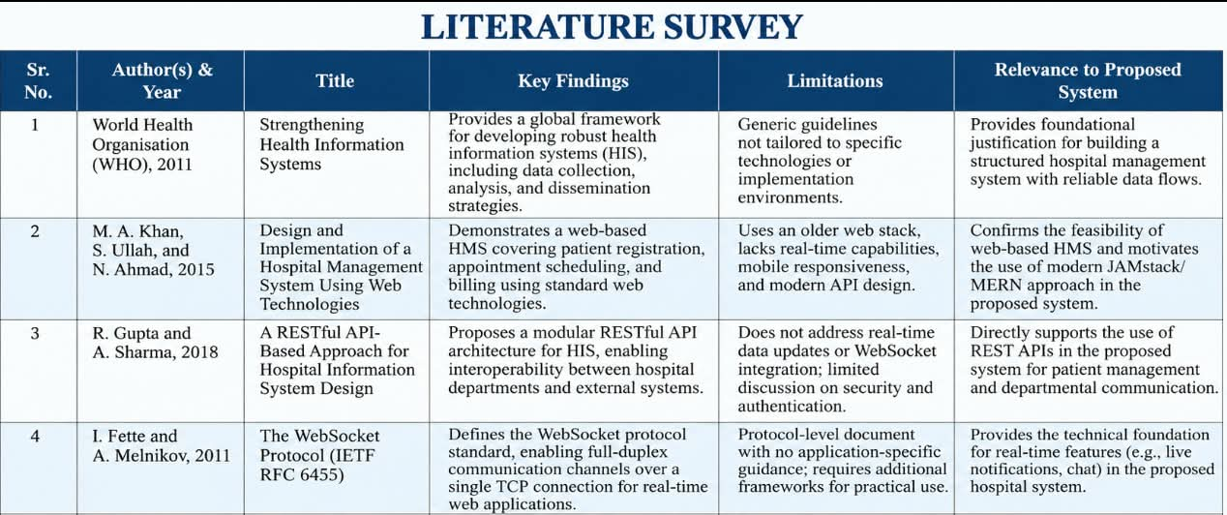

Slide 5
Existing System
Existing System
Phone-based appointment booking
Walk-in registration
Paper/manual patient records
Separate management of doctors and appointments
Limited real-time availability
High dependency on hospital staff
Increased possibility of human errors
Difficult access to patient information
Major Drawback
Healthcare services are not centralized into one efficient digital platform.

Slide 6
Limitations of Existing Research
Based on the research papers:
Some systems use older web technologies.
Several systems lack real-time appointment updates.
Some have limited security and authentication mechanisms.
Scalability can become a challenge with increasing users.
Some systems focus mainly on appointment scheduling rather than complete patient management.
Advanced features such as telemedicine and AI recommendations are often left for future work.
Mobile accessibility and analytics are not always included.
Internet dependency and user onboarding remain challenges.

Slide 7
Research Gap
Research Gap
Existing research provides effective solutions for online healthcare appointment scheduling, but there is still a need for a more comprehensive and integrated platform.
Identified gaps:
Appointment scheduling and patient management are often treated separately.
Limited integration of patient records + appointments + doctor management.
Real-time functionality is not consistently available.
Advanced analytics and personalized healthcare features are limited.
Some systems lack mobile-friendly accessibility.
Telemedicine and intelligent doctor recommendation are mostly proposed as future enhancements.

Slide 8
Proposed System
Our Proposed Solution
Full Stack Healthcare Appointment and Patient Management Platform
The system will provide:
Patient
Registration/Login
Doctor search
Appointment booking
Appointment tracking
Patient profile
Medical/appointment history
Doctor
Login
Manage availability
View appointments
Manage patient information
Update appointment status
Admin
Manage patients
Manage doctors
Manage departments
Manage appointments
Monitor system activities

Slide 9
Conclusion
Existing healthcare systems face challenges in appointment scheduling and patient data management.
Research shows that full-stack web technologies can improve healthcare accessibility and efficiency.
Our proposed platform combines appointment scheduling and patient management into one centralized system.
The system aims to provide a secure, scalable, responsive and user-friendly healthcare platform.

Slide 10
References
Research Papers
Suman, M. & Gossai, K. (2025)
  Design and Implementation of a Full-Stack Healthcare Appointment Scheduling System
  International Journal of Scientific Research & Engineering Trends, Vol. 11, Issue 5.
Tirpude, S., Chudasama, D. & Kharat, M. (2026)
  MediConnect: A Full-Stack Real-Time Hospital Appointment Management System
  International Journal for Research in Applied Science & Engineering Technology, Vol. 14, Issue IV.
World Health Organization, Strengthening Health Information Systems, 2011.

Slide 11
Thank you

